Slide 1
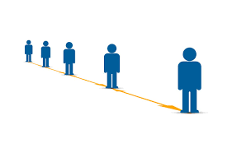
Social Distance Detection with Deep Learning
Authors:
Yew Cheong Hou
Mohd Zafri Baharuddin
Salman Yussof
Sumayyah Dzulkifly
B4 - 1911129
Ayushi Vaghela

Slide 2
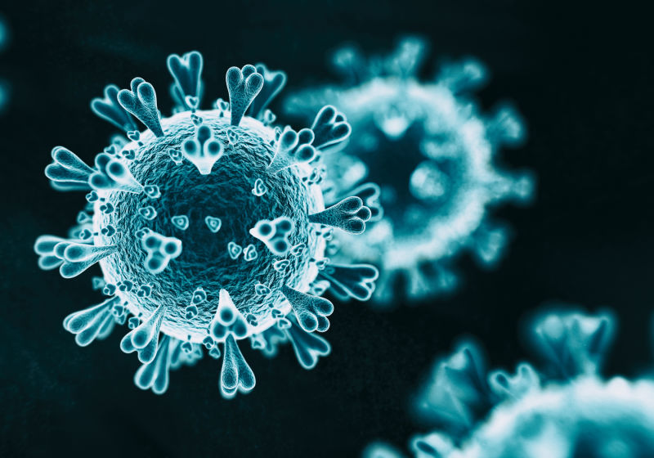
Introduction
Social Distancing is a method used to control the spread of contagious disease.
To break chain of infections, practicing social distancing and self isolation have been deemed as most effective way.
It is observed that people are ignoring public
health measures, especially with respect to
social distancing.
Hence, this project aims for facilitating social
distance through automated detection
using deep learning.
Notes:
How presentation will benefit audience: Adult learners are more interested in a subject if they know how or why it is important to them.
Presenter’s level of expertise in the subject: Briefly state your credentials in this area, or explain why participants should listen to you.

Slide 3
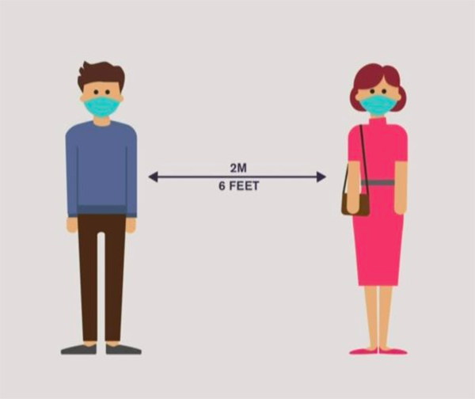
The following points summarizes the main components of this approach:
a. Deep learning has gained more attention in object detection was used for human detection purposes.
b. Develop a social distancing detection tool that
can detect the distance between people to keep
safe.
c. Evaluation of the classification results by
analyzing real-time video streams from the
camera.
Notes:
Lesson descriptions should be brief.

Slide 4
Methodology
This social distancing detection tool was developed to detect the safety distance between people in public spaces.
The deep CNN method and computer vision techniques are employed in this work.
Initially, an open-source object detection network based on the YOLOv3 algorithm was used to detect the pedestrian in the video frame.
From the detection result, only pedestrian class was used and other object classes are ignored in this application.
Hence, the bounding box best fits for each detected pedestrian can be drawn in the image, and these data of detected pedestrians will be used for the distance measurement.

Slide 5
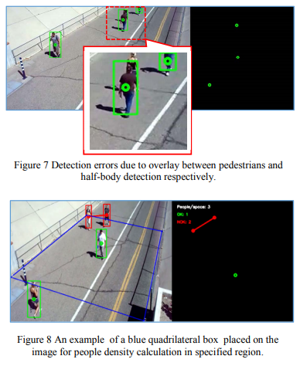
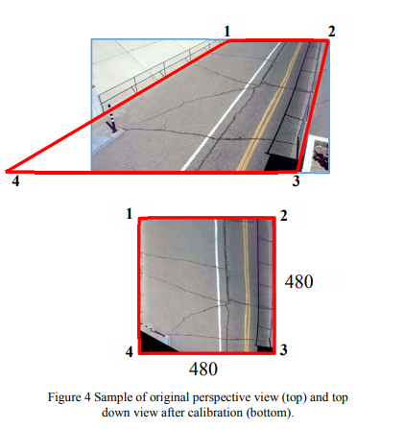

Slide 6
For camera setup, the camera is captured at fixed angle as the video frame, and the video frame was treated as perspective view are transformed into a two-dimensional top-down view for more accurate estimation of distance measurement.
In this methodology, it is assumed that the pedestrians in the video frame are walking on the same flat plane. Four filmed plane points are selected from frame and then transformed into the top-down view.
The location for each pedestrian can be estimated based on the top-down view. The distance between pedestrians can be measured and scaled.
Depending on the preset minimum distance, any distance less than the acceptable distance between any two individuals will be indicated with red lines that serve as precautionary warnings.
The work was implemented using the Python programming language.

Slide 7
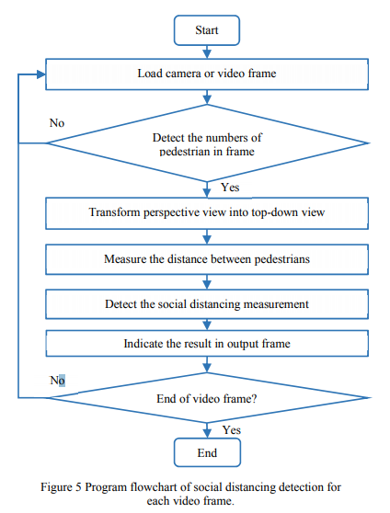
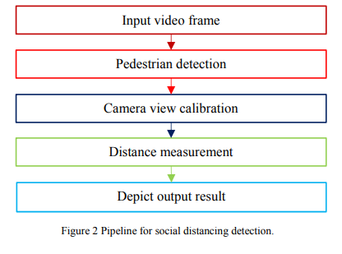
WORKING

Slide 8
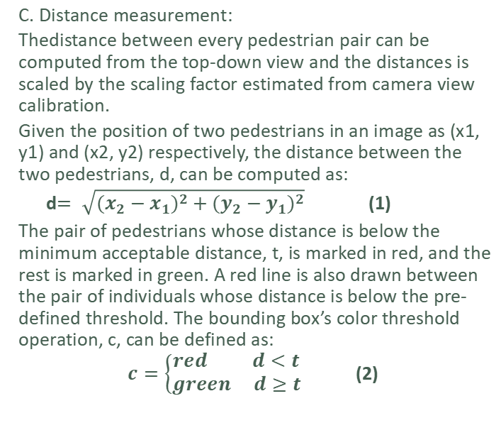
WORKING
A. Pedestrian detection:
In this work, the YOLO model was adopted for pedestrian detection. The YOLO trained on the COCO dataset which consists of 80 labels including human or pedestrian class. In this work, the only box coordinates, object confidence and pedestrian object class from detection result in the YOLO model were used for pedestrian detection.
B. Camera view calibration:
Camera view calibration is applied which works by computing the transformation of the perspective view into a top-down view. The actual distance between pedestrians corresponds to the number of pixels in the top-down view can be estimated.
C. Distance measurement:
Thedistance between every pedestrian pair can be computed from the top-down view and the distances is scaled by the scaling factor estimated from camera view calibration.
Given the position of two pedestrians in an image as (x1, y1) and (x2, y2) respectively, the distance between the two pedestrians, d, can be computed as:
d$= \sqrt{{\left(x_{2}−x_{1}\right)}^{2}+{\left(y_{2}−y_{1}\right)}^{2}}$ (1)
The pair of pedestrians whose distance is below the minimum acceptable distance, t, is marked in red, and the rest is marked in green. A red line is also drawn between the pair of individuals whose distance is below the pre-defined threshold. The bounding box’s color threshold operation, c, can be defined as:
$c=\left\{\begin{aligned}red d<t \\ green d≥t\end{aligned}\right.$ (2)

Slide 9
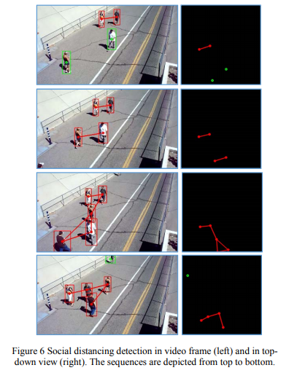
RESULT
In this work, the video frame is fixed at a specified angle to the street. The perspectives view of the video frame is transformed into a top-down view for more accurate estimation of distance measurement.
The red points represent the pedestrians whose distance with another pedestrian is below the acceptable threshold and the green points represent the pedestrians who keep a safe distance from other pedestrians.
The YOLO algorithm is also able to detect the half body of the pedestrian as an object by showing the bounding box, the position of the pedestrian corresponds the middle-point of bottom line is estimated based on the bounding box will less precise.

Slide 10
CONCLUSION
The proposed method was validated using a video showing pedestrians walking on a street.
The visualization results showed that the proposed method is capable to determine the social distancing measures between people which can be further developed for use in other environment such as office, restaurant, and school.
Furthermore, the work can be further improved by optimizing the pedestrian detection algorithm, integrating other detection algorithms such as mask detection and human body temperature detection, improving the computing power of the hardware, and calibrating the camera perspective view.

Slide 11
IMPEMENTATION
Python modules
openCV
scipy - for calculation of scientific and technical computing
argparse - parser for command-line options, arguments and sub- commands
os - miscellaneous operating system interfaces
imutils - series of functions to make basic image processing functions such as rotation, resizing

Slide 12
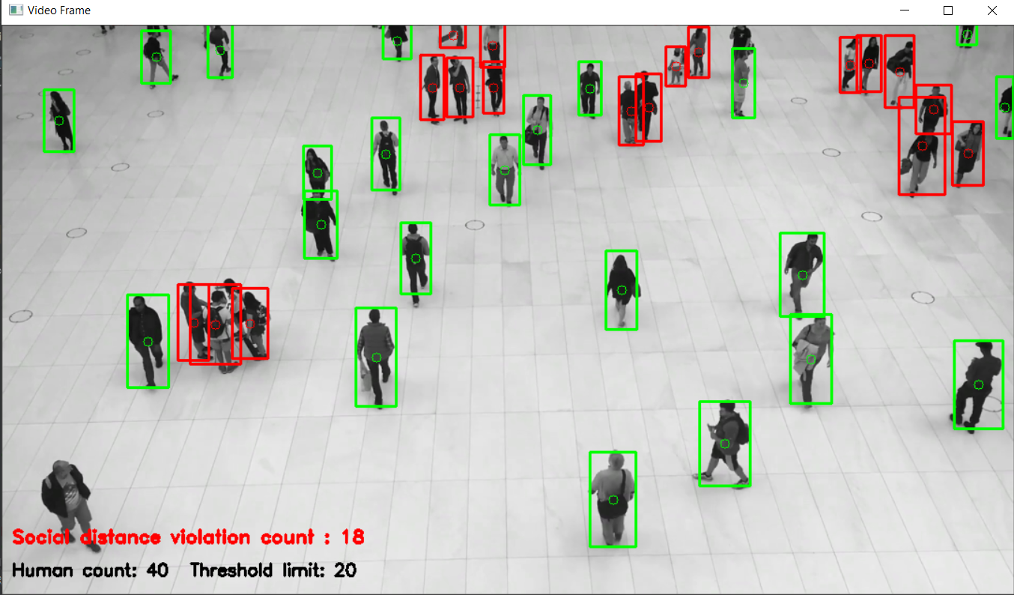
SCREENSHOT FROM IMPLEMENTATION

Slide 13
BILIBOGRAPHY
https://www.google.com/search?q=social+distancing+with+yolo+algorithm&source=lnms&tbm=isch&sa=X&ved=2ahUKEwiVzIz79s_vAhXUbCsKHW9HDy0Q_AUoAXoECAEQAw&biw=1536&bih=666
https://www.cdc.gov/coronavirus/2019-ncov/prevent-getting-sick/social-distancing.html
https://www.medrxiv.org/content/10.1101/2020.08.27.20183277v1.full.pdf
https://towardsdatascience.com/monitoring-social-distancing-using-ai-c5b81da44c9f
https://www.ncbi.nlm.nih.gov/pmc/articles/PMC7603992/
https://learnopencv.com/deep-learning-based-object-detection-using-yolov3-with-opencv-python-c/#:~:text=YOLOv3%20is%20the%20latest%20variant,Single%20Shot%20MultiBox%20(SSD)

Slide 14
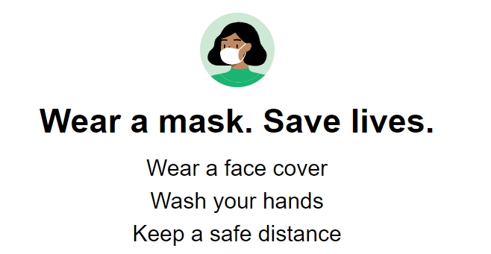
THANK YOU

